Slide 1
Team S’s Studio Setup
Members: JunWei, winston, Ilan, Lovell

Slide 2
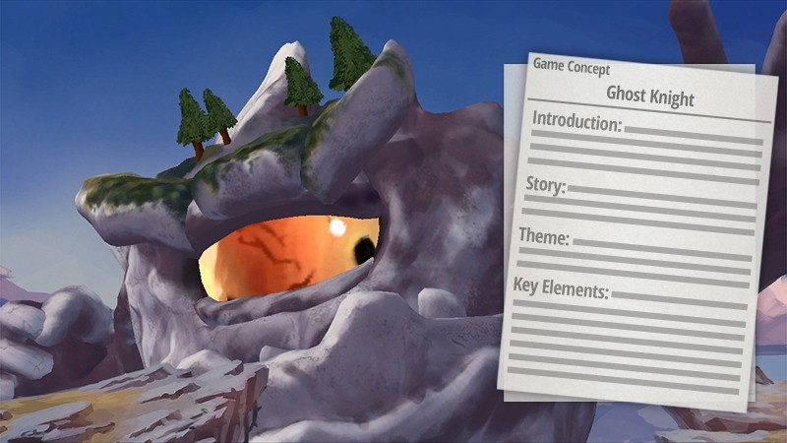
Game Concept
Name: Anime Restaurant Simulation Game
Genre: Fantasy, Idle, Simulation, Management
Play Value: Relaxing
What’s Unique: Able to build your dream restaurant!
Gameplay: Own an establishment, design it, invite customers, get money. Roll gacha for waiters/waitresses and staff
You are the restaurant manager and your job is to build up your restaurant by hiring more maids , upgrade and design your restaurant to the top!
Game Engine : 3D Unity
Played on Mobile(Android/IOS)

Slide 3
release of milestone dates & publicity to gain traction
Further reiteration and features
Development of prototype and crowd testing, ALPHA
2nd round of closed testing, BETA
Use of emergency funds to hire more manpower/work overtime
2nd Month 4th Month 6th Month
1st Month 3rd Month 5th Month
R&D for game idea, design and audience demographics
Implement features, bug fixes and general improvement
Further reiteration and rush funds allocated in case of slower workflow
ROADMAP

Slide 4

Gameplay & Technical Features
Grid style design system
Gacha rolls
Available online and offline
Single player, but can visit friends
System requirements:
2GB of RAM
Android 4.1 and Up
IOS 9.0 and Up

Slide 5
Game Studio Structure
Ilan: Technical Manager and Main developer
1 Extra Programmer
Winston: Design Manager
Jun Wei: CEO, Licensing Manager
1 Extra Designer
Lovell: Creative, art and studio manager
1 Support Member
Publisher
Support Member
1 Support Member

Slide 6

Studio Setup & Budget
Budget valued at: $50,000
All equipment is home owned, cause covid and transition to more work from home jobs
Team communication will be through Zoom & Discord
Extra programmer ($15/h ,5 hours per day ,3 days per week)= $5850
Extra designer ($12/h ,5 hours per day , 3 days per week) = $4680
Support member($12/h , 5 hours per day , 3 days per week)=$4680
Ilan , Winston and lovell Salary = ($8000 X 3 = $24000)
Total Staff Salary = $39210
Jun Wei Salary = ($10000)
Equipment and software <$1k(rental and purchase)
$52.99 Adobe Creative Cloud Software for 6 months ($318 Total)uses microsoft and unreal
Total $250 allocated to trademark the game logo and title under IPOS

Slide 7
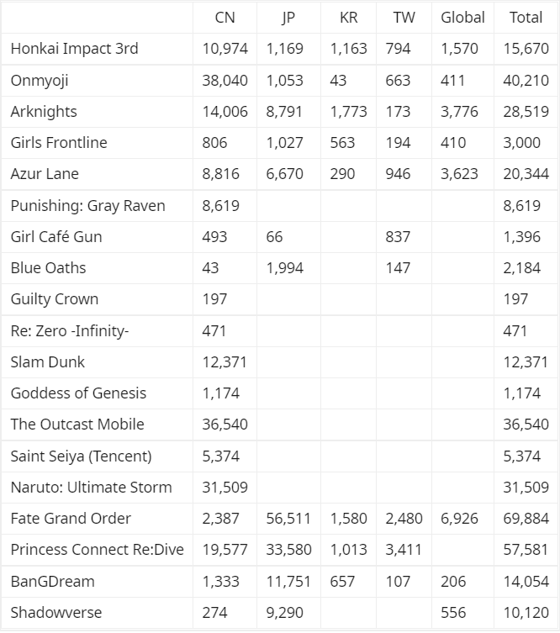
Market Research
How much revenue Anime Gacha games made in June 2020 ( USD in thousands ) :
Market for gacha games in Asian countries, such as China and Japan, is flourishing more than its Global counterpart. ( i.e English releases of the game)

Slide 8



Food Street
Synopsis:
Restaurant management game that puts you in charge of your own restaurant.
Market Overview:
Earned $50k in estimated monthly revenue as of September 2021.
Downloaded 9-10k times in September of 2021.
Estimated download:5mil

Slide 9
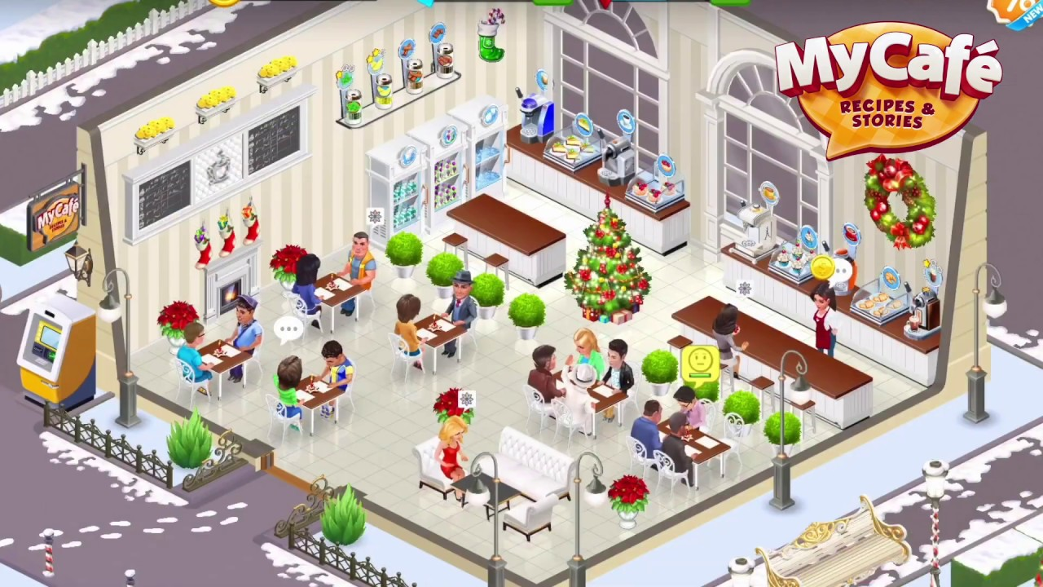

MyCafe
Synopsis:
Players can manage the restaurant however they want. They decide on their cafe’s strategy and earn income, even when they are offline.
Market Overview:
Earning 800k/ month in revenue
Downloaded 200k times in just September 2021
Estimated downloads:50mil

Slide 10


Shop Titans
Synopsis:
Design, build, and customise your own thriving shop in this tycoon simulation adventure. Management Game.
Market Review:
Earned $300k in revenue in September 2021
Downloaded 10k times in September 2021
Estimated download :1Mil

Slide 11
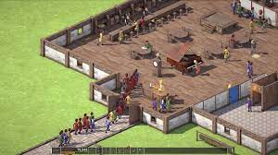
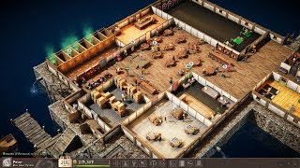
Tavern Tycoon
SYNOPSIS:
Run your fantasy RPG tavern - let travellers take shelter for the night and serve 'em the best mead of their life with a good dose of humor.
Market Review:
Earned ??
74k downloaded players as of 2021.

Slide 12

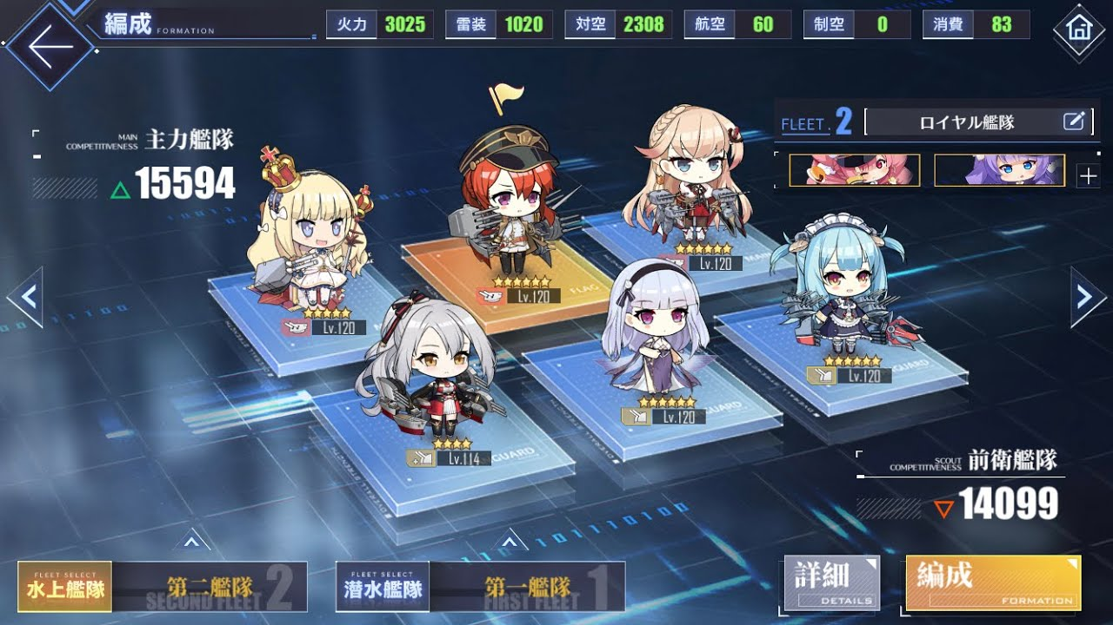

Azur Lane
Synopsis:
Build, manage and battle with your own naval fleet in a beautifully designed anime game, with a unique mix of RPG, 2D shooter and tactical genres. Get new ships for your fleet by rolling in the gacha.
Market Overview:
Earned $1M in revenue in September 2021
Downloaded 90k times in September 2021
Estimated downloads:5mil

Slide 13
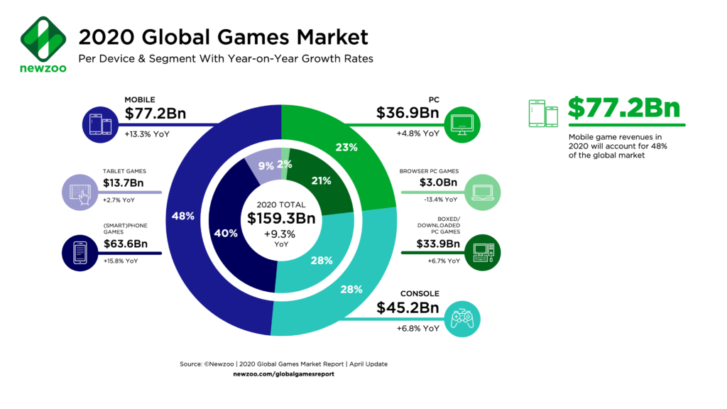
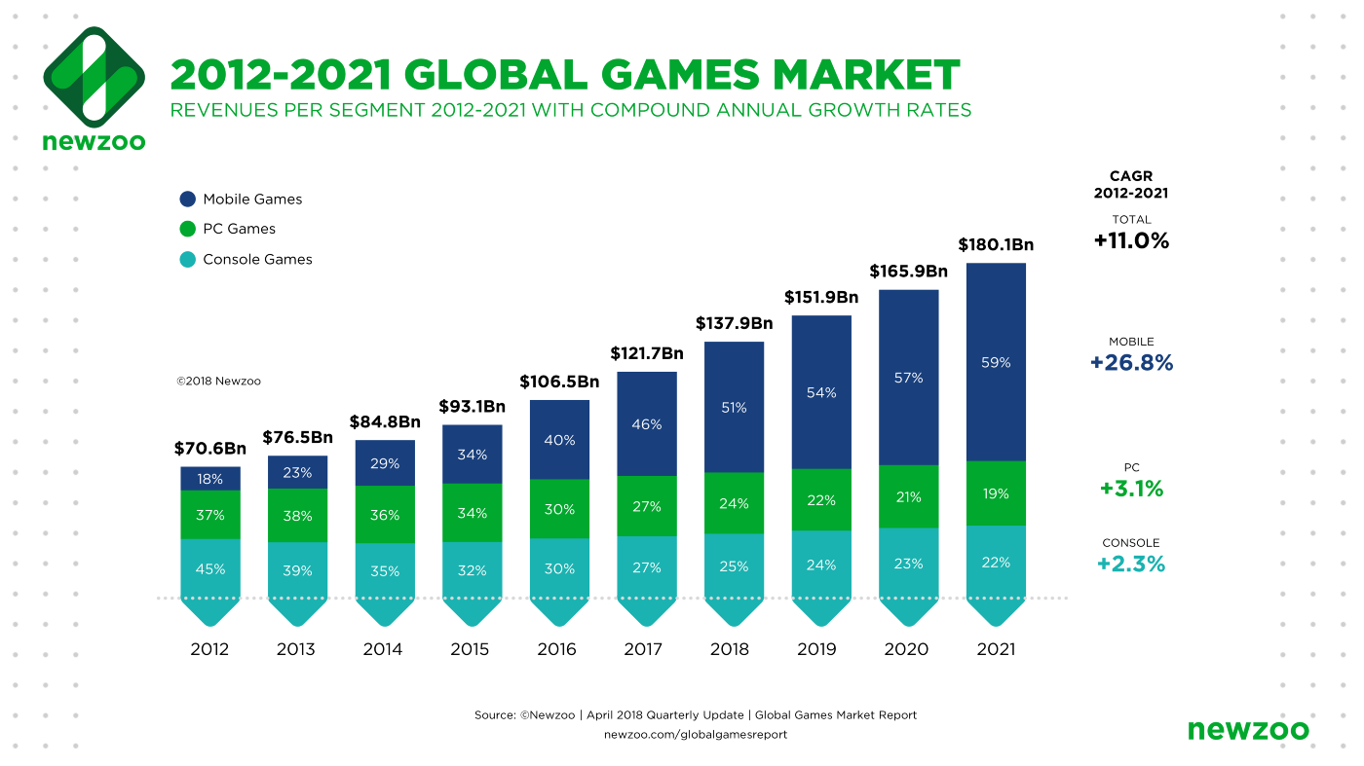
Projected player spendage set to reach 138 billion by 2025
It is also predicted that there will be 3.07 billion mobile players by 2023
Casual Games account for 78% download share
Mobile games account for at least 60% of app distributor revenue share
Mobile ad spend reached 240 billion in 2020
WHY ON MOBILE?

Slide 14
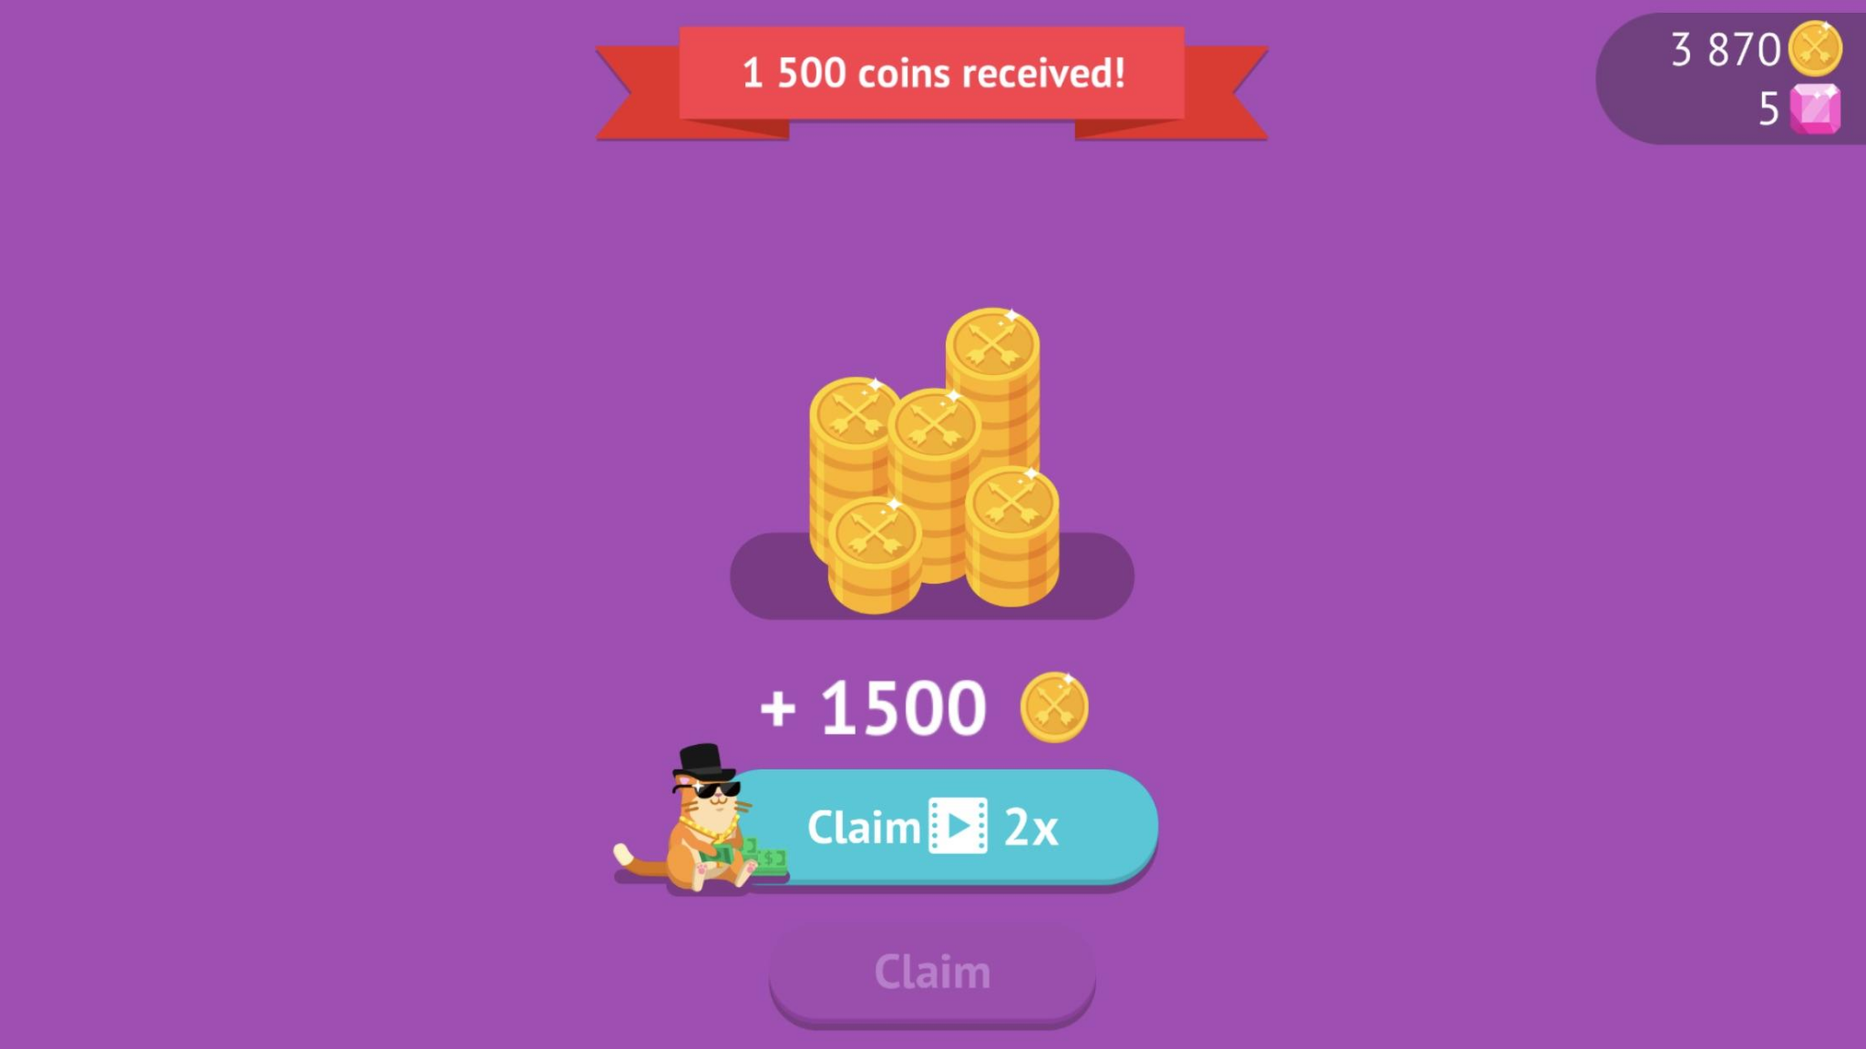

How do we make money from a free game?
Advertisements, hyper casuals watch 2x more ads than other genres
Incentivized ads are watch by more females than males
Full return on ad spend within 2 weeks, 2x return within 3 weeks
In-game purchases account for 95% of total user spend
5% of females and 3.3% of males spend on in-app purchases
Asia had an average $6 eCPM in the world
eCPM, short for “effective cost per mille,” is how much an advertiser pays for an ad space per unit of 1,000 ad impressions

Slide 15
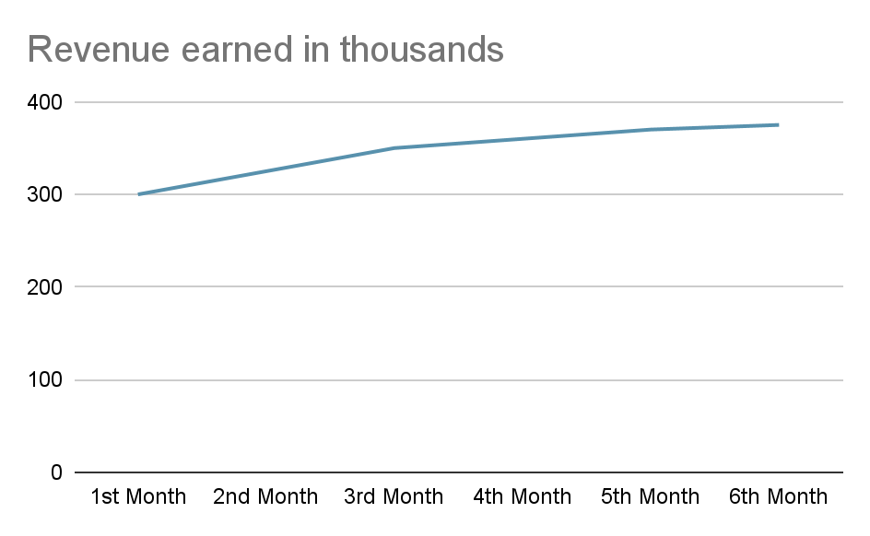
Projection of revenue for the first 6 months
Steady revenue growth, alongside download count
Estimated 1 million downloads within 1 year
$2+ million earned in the first 6 months
Most significant increase happening in the early months of release
Will profit greatly and make the money back within the first month

Slide 16

IP stuff
We are not eligible for patents and copyrights are too expensive and slow. Thus we are going to trademark the game.
Images, Music and visual assets belong to the developers by publishment, while only the name and brand needs to be trademarked with a related company.
Singapore has secure and fast trademarks for the low cost of $300-500, which falls under budget.

Slide 17
Task Allocation
Jun Wei | Game concept 80% | Game studio structure | Studio setup | IP trademark
Winston | Similar games 50% | Game concept 5% | Budget allocation 50% | adverts/ monetizations | Timeline
Ilan | Market Research | Game Concept 5% | Projection of Revenue
Lovell | Similar games 50% | Game concept 5%

Slide 18
Links/References for Sources:
https://shopee.sg/2020-New-HUION--Kamvas-13-Drawing-Monitor-Pen-Display---for-Digital-Art-and-Writing--Supports-Windows--Mac---Android--i.290050563.7845862900
Market for anime gacha games in June 2020: https://www.reddit.com/r/gachagaming/comments/hooftz/june_2020_revenue_of_anime_gacha_games_china_and/
Food Street overview: https://sensortower.com/ios/us/supersolid-ltd/app/food-street-restaurant-game/935623337/overview
Azur Lane overview: https://sensortower.com/android/us/yostar-limited/app/azur-lane/com.YoStarEN.AzurLane/overview
Shop titans overview: https://sensortower.com/ios/us/kabam-games-inc/app/shop-titans-craft-build/1361253233/overview
Tavern Tycoon overview: https://playtracker.net/insight/game/16715
https://www.blog.udonis.co/mobile-marketing/mobile-games/mobile-gaming-statistics

